Slide 1
MIS670 Capstone
Video Game Sentiment Analysis
By: Carter Burkhart, Saurabh Singh, David Meierer

Slide 2
Background-Why is this important
Big game developing publishers have gotten so entrenched into “big money” and being corporate machines that they forget to recognize what the consumer’s feelings or “sentiment” of their products is every time they publish their AAA priced games.
Marketing 101: what does the consumer want?
Happy consumers usually corresponds to an increase in product sales
Our data analysis can bring insight to what game developing publishers’ consumers are thinking about their games.
Knowing what their customers think will allow them to sustain current customers and optimistically increase the number of customers which buy their products

Slide 3
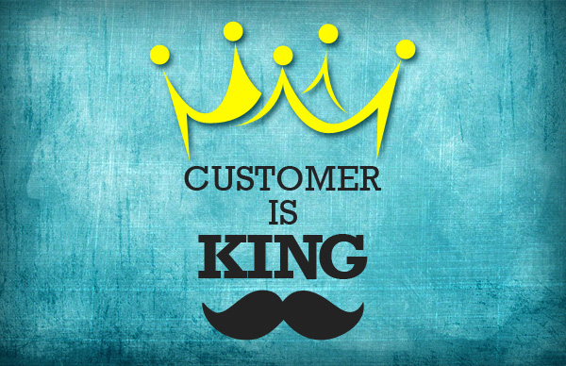
Business Question
What is the best way to increase customer satisfaction and increase customer purchases of big title releases.

Slide 4
Data Collection Process
We decided to grab data from twitter
Focused on big release games for this year
Destiny 2
Assassin’s Creed Origins
Middle Earth: Shadow of War
South Park The Fractured But Whole
Star Wars Battlefront II
Over 3GB of data collected
Over 300,000 tweets collected
We analyzed over 150,000 tweets

Slide 5
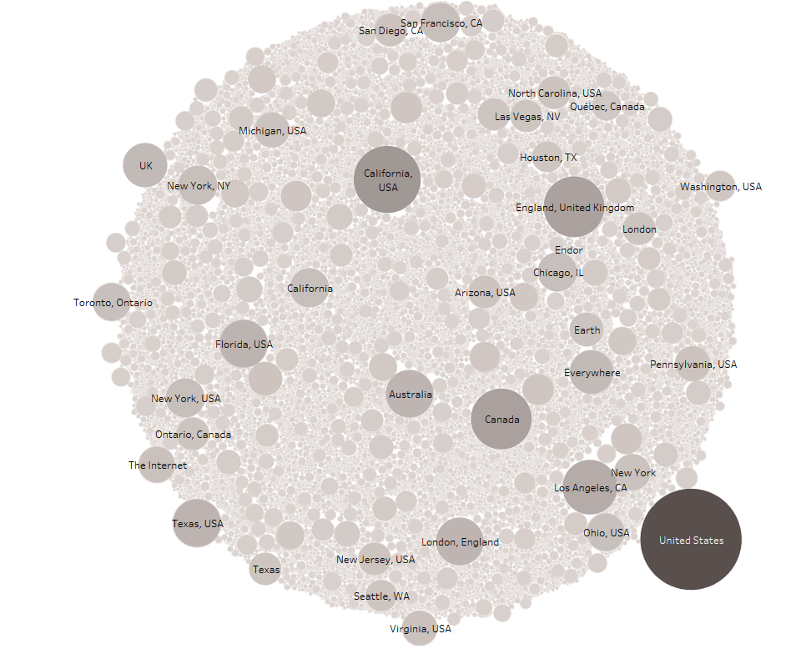
Where is the Consumer?

Slide 6
Insights From Data Processing
Sentiment Analysis
Sentiment Results
Destiny 2 (11629 positive, 2399 negative, 27841 neutral)
Assassin's Creed Origins (1442 positive, 860 negative, 2498 neutral)
Shadow of War (870 positive, 166 negative, 919 neutral)
South Park (230 positive, 47 negative, 2820 neutral)
Star Wars Battlefront II (16979 positive, 26547 negative, 46785 neutral)

Slide 7
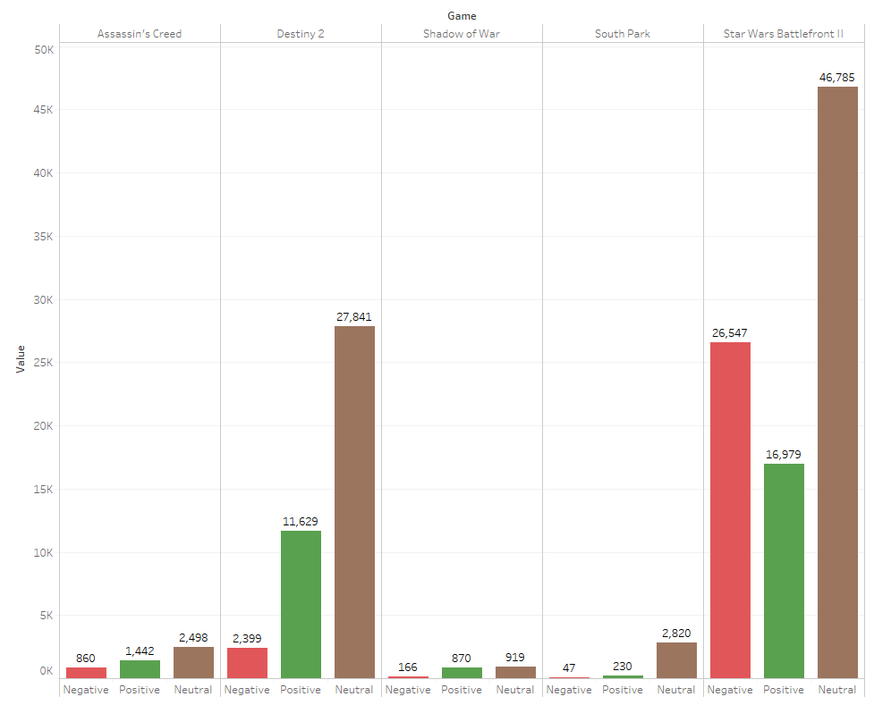
Visualize Sentiment Analysis

Slide 8
Insights from Data Processing
Word Frequencies
Overall when looking at the word frequencies for positive, negative, and neutral sentiment:
Aspects of the game that were either good or bad were reflected in sentiment
Positives: level design, writing, gameplay
Negative: improper game balance, anti consumer practices (microtransactions)
Neutral: general promotional items, partnerships

Slide 9
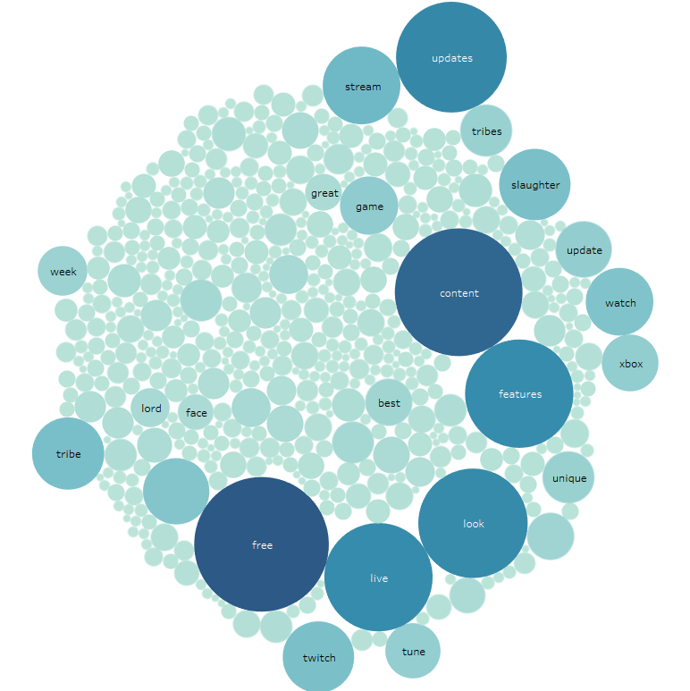
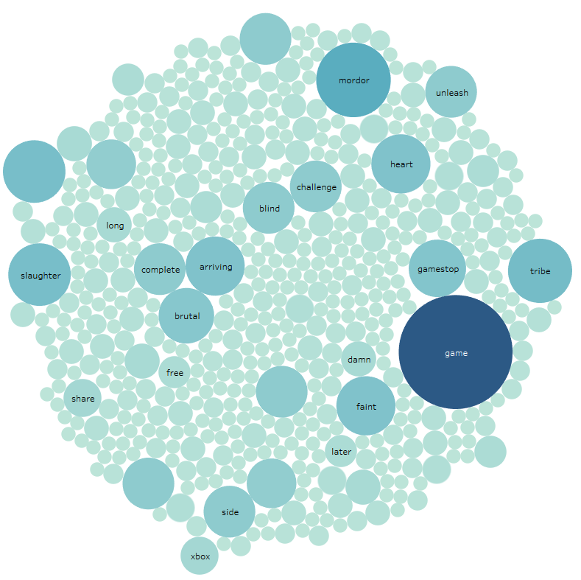
Word Frequencies Visualization
Shadow of War

Slide 10
Concluding Remarks
Given the results, we have come to the following conclusions:
Customers are keen to voice their opinions on likes and dislikes
Game design components especially
Developers and publishers should build on things that worked
Positive Sentiment Translation
Continue popular game system/mechanic that people enjoy
Neutral Sentiment Translation
Using streaming sessions with promotions can increase accessibility and awareness
Negative Sentiment Translation
Be mindful of practices that upset consumers and adapt those practices to a more customer friendly approach

Slide 11
Questions?

